Slide 1




Notice
Warning
new song Arrived
If you feel dizzy, stop playing the game
Team play
SOLO
COmpetiton
Now Play
If you continue to feel dizzy,
visit a hospital or doctor.
POP/stars – K/DA
Collection
settings

Slide 2

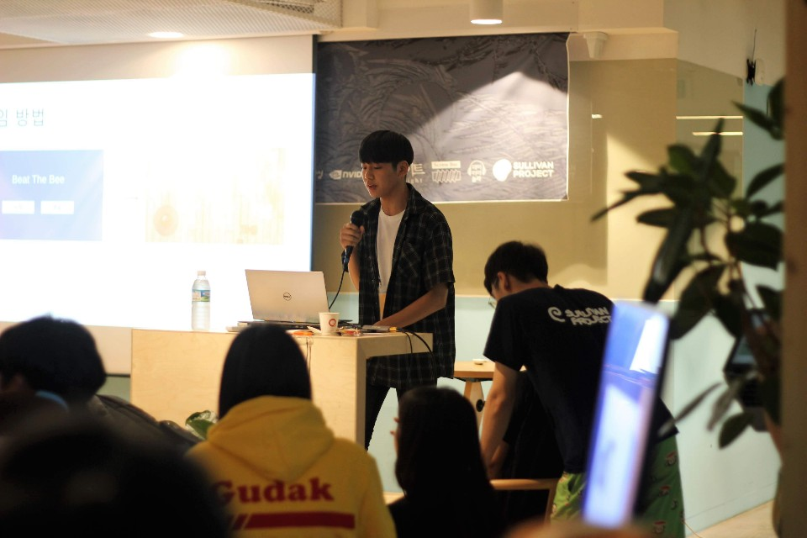




Music Select
Ddu-du-ddu-du
Global Ranking
My records
blackpink
ranking
username
score
pop/stars
date
score
rank
1
2
3
4
5
6
Nickname
Nickname
Nickname
Nickname
Nickname
nickname
000000
000000
000000
000000
000000
000000
k/da
2019/03/20
2019/03/20
2019/03/20
2019/03/20
2019/03/20
2019/03/20
000000
000000
000000
000000
000000
000000
SS
Ss
Ss
Ss
Ss
Ss
LA vie en rose
IZ*ONE
La vie en rose
Yes or yes
Iz*one
twice
Fake love
GAME STArt
bts
Click this button to play

Slide 3
Collection
획득 날짜 순
희귀도 순
기본 펜라이트
모 델 링 돌 아 감
My achievements
locked achievements
19/06/24
라라라 라미란로즈
WIZ*ONE 펜라이트
애미뒤진 식도염
19/06/28
RARe
19/06/24
“la vie en rose” ss rank clear
식도염 낫기
Reward : my health
윤성팍 펜라이트
윤성파크
19/06/25
EPIC
메르세데스 140레벨
19/06/25
19/06/27
19/06/24
“Fake love” ss rank clear
메가 버닝
Reward : bless of elf
씨발머리존나아프네
기본 펜라이트
획득일 : 19/06/25
NORMAL
Down down down down
19/06/26
NORMAL
본캐 직업
Penlight Dancing 첫 실행 시 지급되는 펜라이트이다.
19/06/24
“pop/stars” ss rank clear
엄마뒤진식도염
뭘로 하지?
Reward : maplestory
19/06/25
NORMAL
Use this penlight

Slide 4
option
Game control
vr control / sounds
Hud
Music volume
100
ON
OFF
Visual effect
Sound effects volumes
ON
OFF
100
One-hand mode
Player height
ON
OFF
160cm

Slide 5

Collectin
Game Result
A
Global Ranking
My records
ranking
username
score
date
score
rank
1
2
3
4
5
6
Nickname
Nickname
Nickname
Nickname
Nickname
nickname
000000
000000
000000
000000
000000
000000
2019/03/20
2019/03/20
2019/03/20
2019/03/20
2019/03/20
2019/03/20
000000
000000
000000
000000
000000
000000
SS
Ss
Ss
Ss
Ss
Ss
La vie en rose
rank
Iz*one
Score 000,000
Go to music select
Best score 000,000
Combo x 000
REtry
Best Combo x 000

